Slide 1
Make the Phirst Day Phun
Plenty of time later for rules
Consider a “Greensheet” quiz
Embed rule questions on labs and other assignments
Do labs and activities on the first day
Roadrunner cartoons
Physics 500

Slide 2
Recruit Students
Dean Baird’s Take Physics Posters
Institute of Physics Posters
Brochure
Talk to Feeder Science Classes
Promotional Movie
Visible Student Projects
Re-examine Course Prerequisites/Requirements

Slide 3
Kinematics
Motion Sensor Lab
Motion Graph Slides
Super Ultimate Graphing Challenge
http://theuniverseandmore2.blogspot.com/
Acceleration Slides
Determine the Ceiling Height
Magic Bee Problem
Freefall Introduction Slides
Reaction Time Lab

Slide 4
What is the Relationship between Distance and Time When Dropped?
Average Velocity is the Average of the Initial and Final
The Final Velocity is the Acceleration Multiplied by Time
The Distance is the Average Velocity Multiplied by Time

Slide 5
Reaction Time Lab
Reaction Time Measurement
Repeat with added Weight
Repeat on the Moon!
M
M_{R}

Slide 6
Vectors and Projectiles
Vector Addition PhET Simulation
Dropped Vs Shot Bullet
Intro to Projectiles Slides
Bull’s eye Lab
Monkey and Hunter
Projectile Motion PhET Simulation
Projectile Motion Screencast
Projectile Launching Devices

Slide 7
Newton’s Laws
Newton’s First Law Video, Lab, and Slides
Egg Trick
Newtonian Shot, from Dean Baird’s Book of Phyz
Drag Racing with the “Physics” Cube
Newton’s Third Law Slides
Forces Always Come in Pears
Elevator Lab

Slide 8
Elevator Lab
Rode elevator in hi-rise office building with a 0.5 kg mass hanging from a force probe
Students use NSL to convert force data to acceleration data
Students integrate acceleration to get velocity and velocity to get position using DataStudio
Students determine at what floors elevator stops
Students are introduced to elevators with an Interactive Engagement slide show

Slide 9
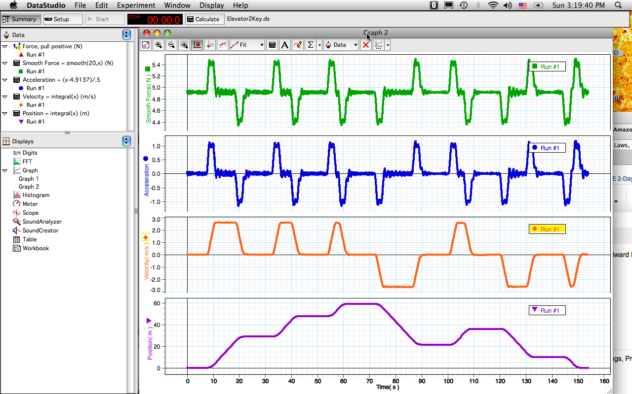
Elevator Lab Final Results
Slides

