Slide 1
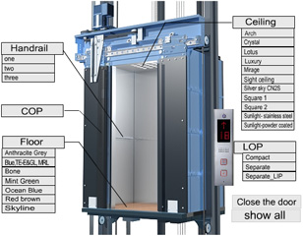
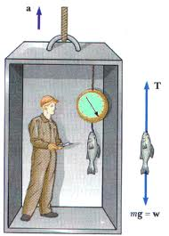
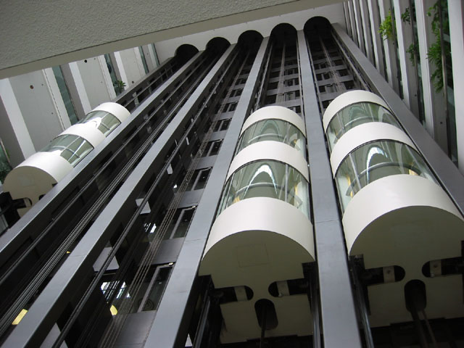

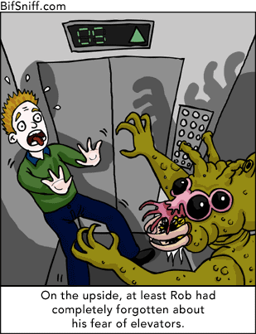
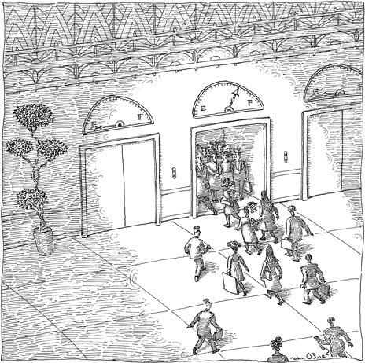
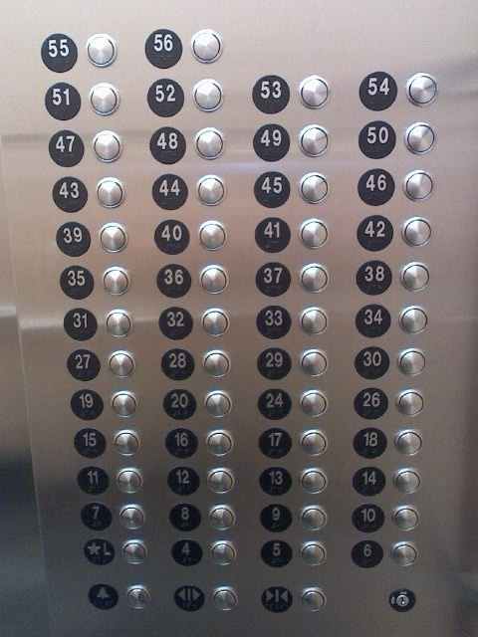
Elevators
The Ups and Downs of Newton’s Second Law

Slide 2
Elevator Rules
Elevators only travel up or down
Elevators speed up to a constant velocity
Elevators always slow down next after reaching a constant velocity
Elevators always slow down to a stop
Elevators always play bad music
No one talks on an elevator

Slide 3
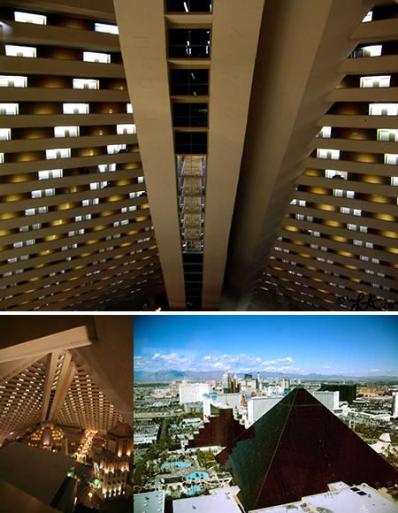
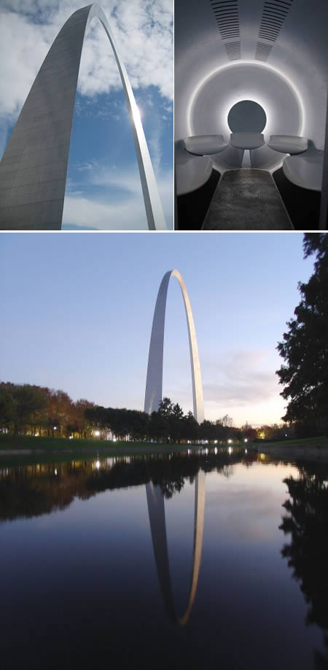
Elevator Rules Exceptions
Luxor “Inclinator” travels at a 39º angle to the horizontal
Gateway Arch changes angle as it moves

Slide 4
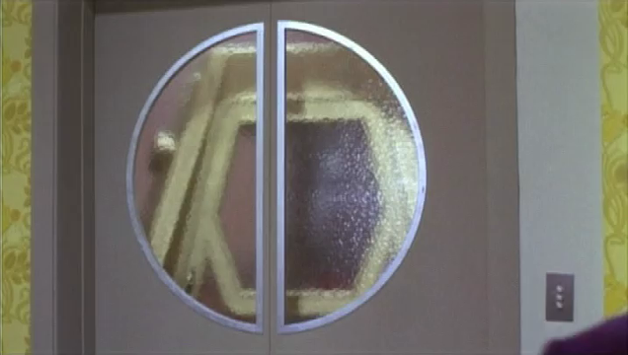
Wonkavator Doesn’t Stop Accelerating!

Slide 5
When do you Feel Heavy on an Elevator?
Increasing speed on the way up
And?
Decreasing speed on the way down
When do you Feel Light on an Elevator?
Decreasing speed on the way up
Increasing speed on the way down
And?
When do you Feel Normal on an Elevator?
When the elevator is at rest
When the elevator is moving at constant velocity
And?

Slide 6
Acceleration on an Elevator
Which situation(s) result in an upward acceleration?
A. Increasing speed on the way up
B. Increasing speed on the way down
C. Decreasing speed on the way up
D. Decreasing speed on the way down
The Acceleration is Up When you Feel Heavy

Slide 7
Acceleration on an Elevator
Which situation(s) result in a downward acceleration?
A. Increasing speed on the way up
B. Increasing speed on the way down
C. Decreasing speed on the way up
D. Decreasing speed on the way down
The Acceleration is Down When you Feel Light

Slide 8
Acceleration on an Elevator
Which situation(s) result in a zero acceleration?
A. When the elevator is at rest
B. When the acceleration has reached a steady positive value
C. When the acceleration has reached a steady negative value
D. When the elevator has a constant velocity
The Acceleration is Zero When you Feel Normal

Slide 9
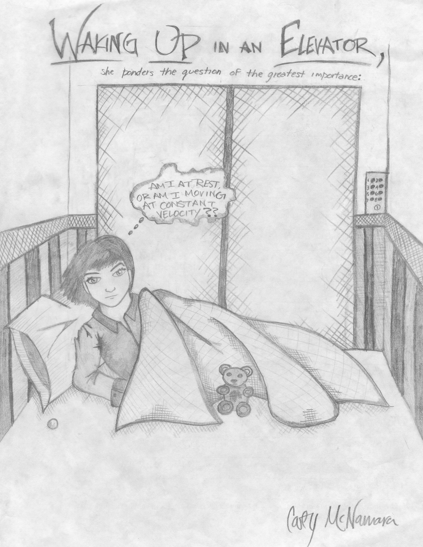
If you were to wake up on an elevator you couldn’t tell if you were moving at constant velocity or at rest

Slide 10
What will the scale read if the elevator is at rest?
Snowman mass = 50 kg, Scale Reading is Normal Force
N
+
mg
????????
490 (N)

Slide 11
What will the scale read if the elevator has
an upward acceleration of 2 m/s² ?
Snowman mass = 50 kg
(he doesn’t melt)
N
+
mg
Scale reads 590(N) increasing speed on the way up OR decreasing speed on the way down
????????
590 (N)

Slide 12
What will the scale read if the elevator is
moving at a constant velocity?
Snowman mass = 50 kg
N
+
mg
Scale reads 490(N) for constant velocity on the way up or way down (and when at rest)
????????
490 (N)

Slide 13
What will the scale read if the elevator has
a downward acceleration of 3 m/s² ?
Snowman mass = 50 kg
N
+
????????
340 (N)
mg
Scale reads 340(N) increasing speed on the way down OR decreasing speed on the way up

Slide 14
What will the scale read if the elevator has
a downward acceleration of 9.8 m/s² ?
Snowman mass = 50 kg
N
+
????????
0 (N)
mg
Scale reads 0(N) increasing speed on the way down OR decreasing speed on the way up

Slide 15
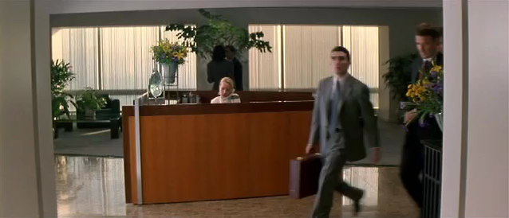
What Has to Happen for an Elevator to have a Downward Acceleration of 9.8m/s²?

Slide 16
What will the scale read if the elevator has
a downward acceleration of 19.6 m/s² ?
Snowman mass = 50 kg
N
490 (N)
?
+
mg
Scale reads the same as when the elevator is at rest, but what will be different?

Slide 17
What is the acceleration if the scale reads 400 (N)?
Snowman mass = 50 kg
N
+
400 (N)
mg
Elevator is either increasing speed on the
way down or decreasing speed on the way up

Slide 18
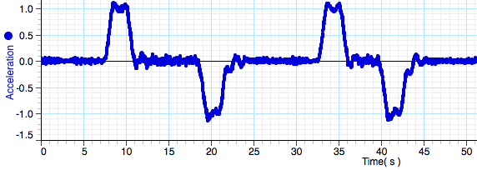
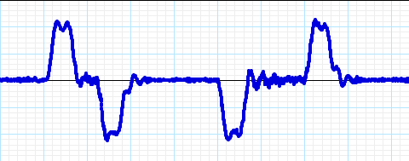
Match the descriptions below to the numbered regions on the acceleration Vs time graph from an elevator ride, assume the elevator started from rest
2
5
7
8
1
3
4
6
9
Decreasing speed on the way up
4
Elevator at Rest
1
5
9
Elevator moving at constant velocity
3
7
Increasing speed on the way up
2
Decreasing speed on the way down
8
Increasing speed on the way down
6

Slide 19
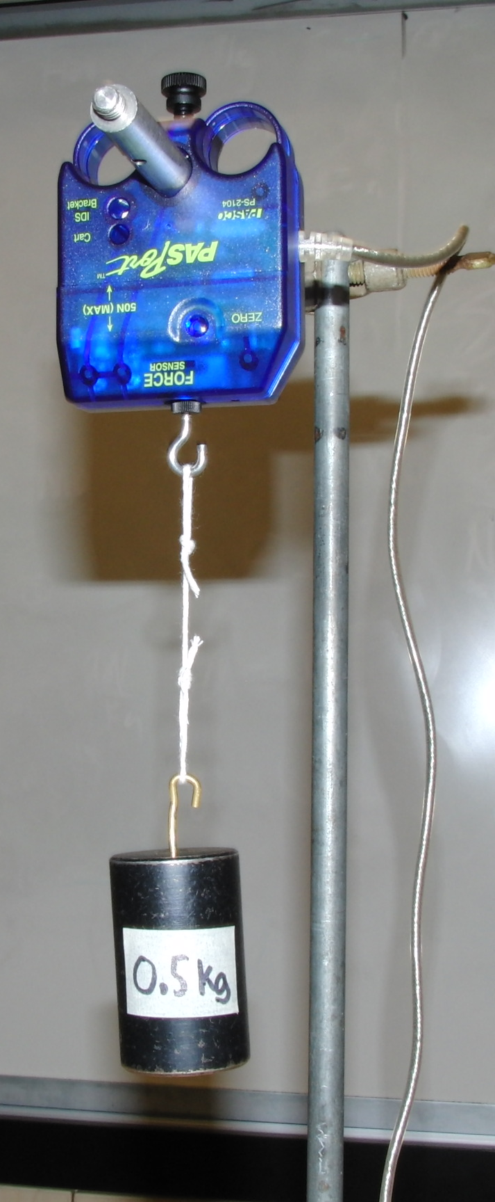
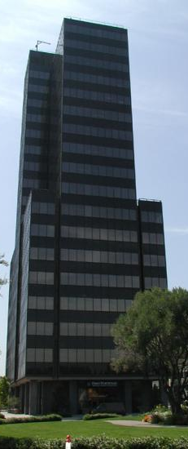
Elevator Lab
You will be given Force Vs Time data for mass on a force sensor riding the elevator at the Pruneyard Towers
Use Newton’s 2nd Law to determine the acceleration Vs Time graph
Use kinematics to determine the velocity and position graphs
Knowing that the elevator started at rest on floor 1, determine the floors it stopped at
Follow Directions!!!

Slide 20
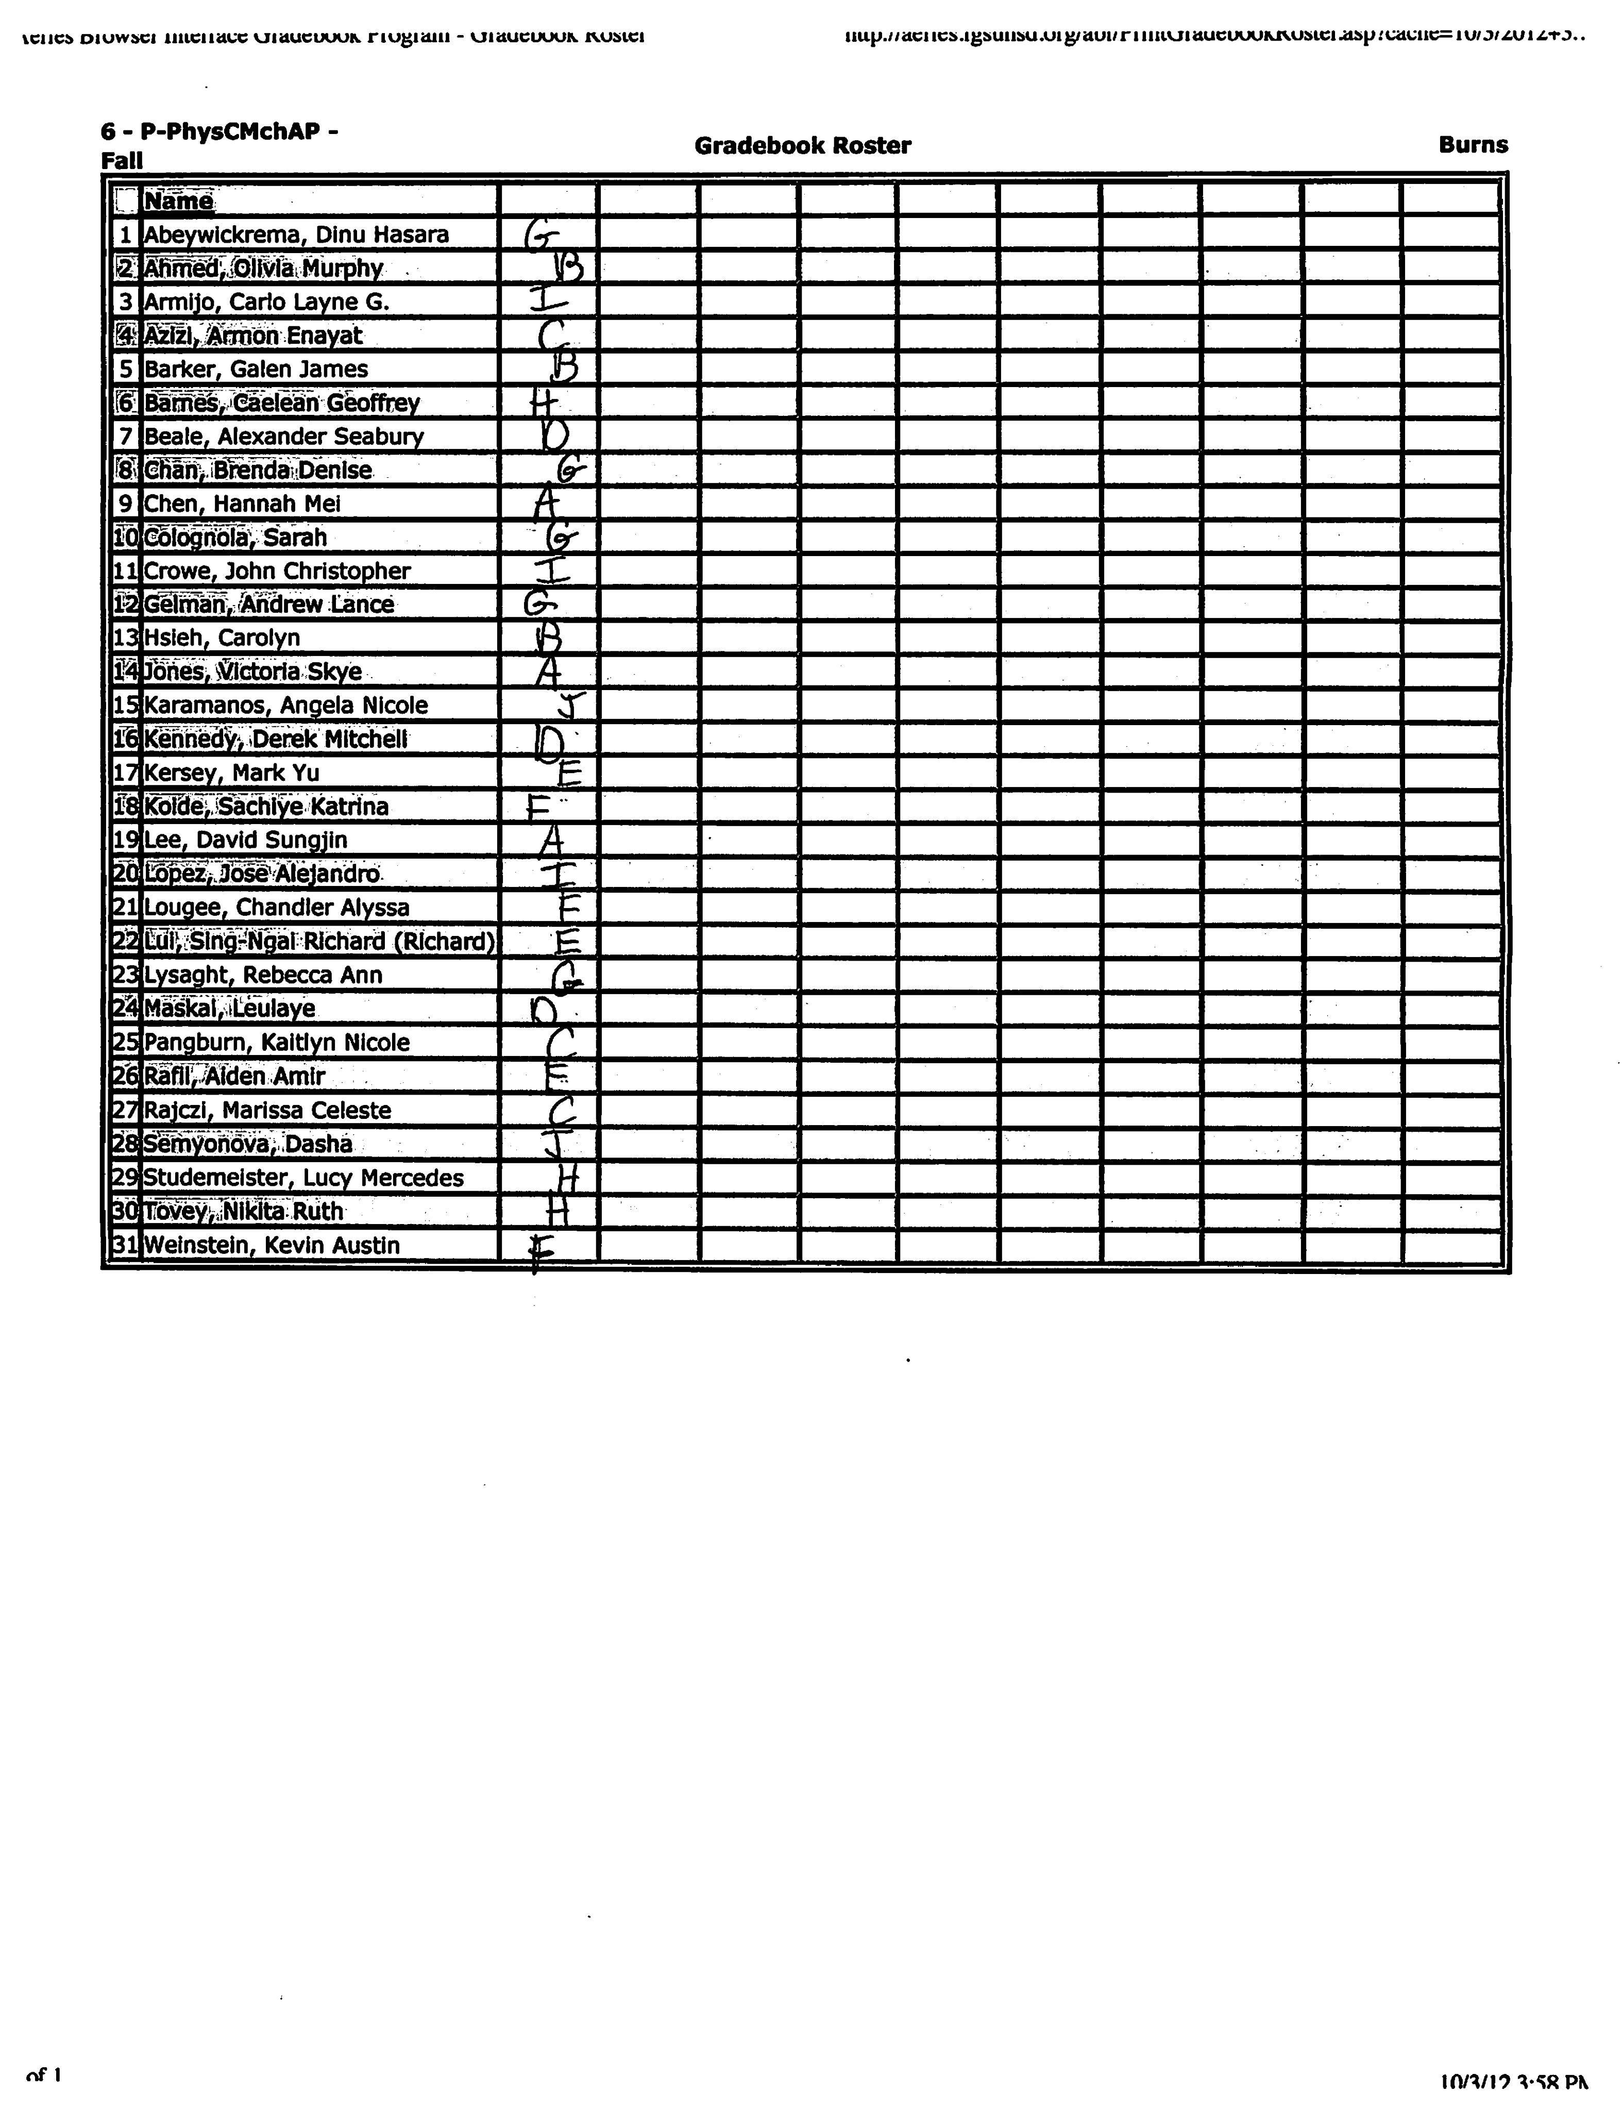
New Lab Groups
Letter Indicates your assigned computer

Slide 21
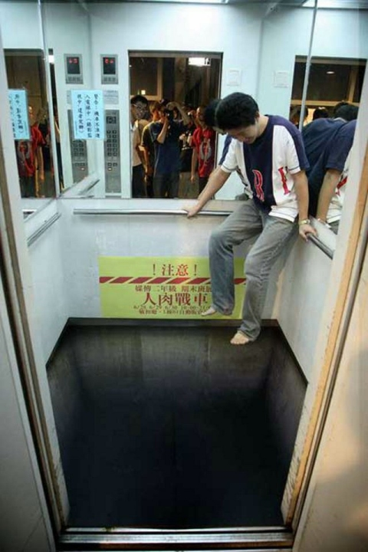
Fun Things to do on an Elevator
1. When there's only one other person, tap them on the shoulder, then act like it wasn't you.
2. Pretend the floor button gives you a shock. Smile, and go back for more.
3. Ask if you can push the button for other people, but push the wrong ones.
4. Bounce a superball around the elevator.
5. Drop a pen and when someone reaches to help pick it
up, scream "THAT'S MINE!”
6. Bring a camera and take a picture of everyone in the elevator.
7. Move your desk into the elevator and when ever someone gets on, ask from behind your desk "Do you have an appointment?”
8. Lay down a Twister mat and ask people if they want to play.
9. Act like a flight attendant and review emergency procedures and exits with the passengers.
10. Dressed in coveralls, get in a full elevator and when the door closes, push the stop button, post an out of order sign inside and go to work on the access panel, saying "This may take a minute."
11. Push the call button, when the voice answers ask, "Is that you God?”
12. When the doors close, announce to the others,
"It's Okay, don't panic, they open up again.”
13. Push your floor button with your tongue.
14. Shoot rubber bands at everyone.
15. When the doors open, pretend that you bounce off a force field when you try to leave.
16. As people get on, ask for their tickets.
17. If other people are talking, ask them to be quiet.
18. Jump Rope.
19. Call out a Group hug.
20. Paint the floor like this!

