Slide 1
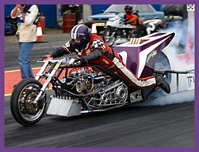
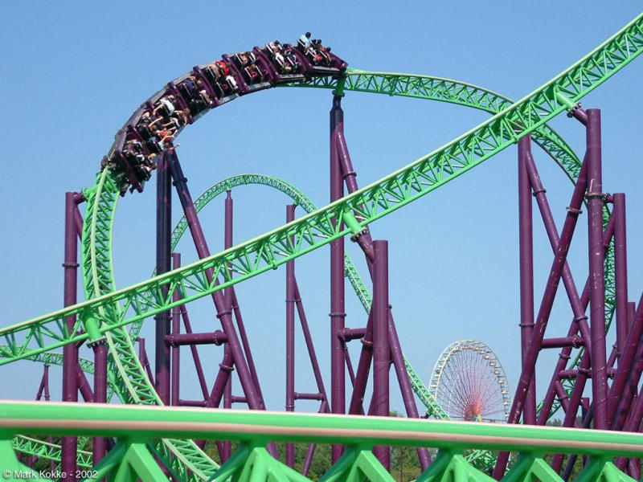
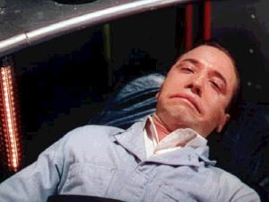
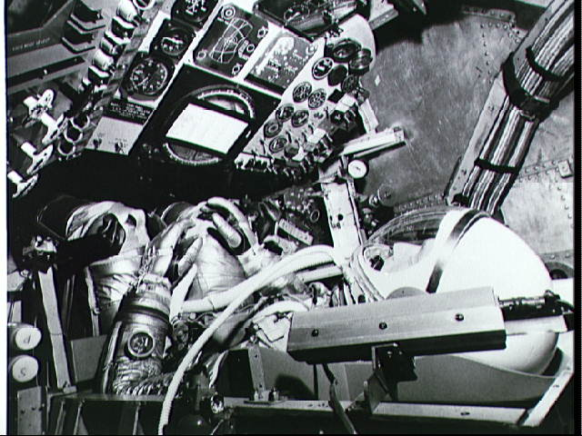
Constant Acceleration
A Difficult Concept that You Can Feel!

Slide 2
Which of the Following are Possible Situations?
An object has zero velocity and positive acceleration
An object has zero acceleration and positive velocity
An object has increasing velocity and decreasing acceleration
An object has negative velocity and positive
acceleration
2 Only
4 Only
2 and 3 Only
1 and 4 Only
All are possible

Slide 3
Which of the Following Have a Positive Acceleration?
Speeding up while moving in the + direction
Slowing down while moving in the + direction
Slowing down while moving in the - direction
Speeding up while moving in the - direction
1 and 4 Only
1 Only
4 Only
1 and 3 Only

Slide 4
Which of the Following Have a Zero Acceleration?
Airplane flying level due east at a constant 500 mph
Child on a spinning merry-go-round
Ball thrown straight up at its highest point
Ball reversing direction after rolling up a ramp
1 Only
1 and 2 Only
1, 3 and 4 Only
1 and 3 Only

Slide 5
A Ball is Given a + Initial Velocity and then Rolls up a Ramp as Shown Below
+
What will happen to its Velocity and Acceleration as it Rolls up the Ramp?
V Decreases, A Increases
V Decreases, A Decreases
V Decreases, A Constant
V Constant, A Constant

Slide 6
The Ball Continues up the Ramp and Reaches Its Highest Point
+
What is the Ball’s Acceleration at this Point?
Zero
Smaller than Before, but not zero
Same as Before, but changes sign
Same as Before

Slide 7
The Ball is Now Rolling Back Down the Ramp
+
What will happen to its Velocity and Acceleration as it Rolls Down the Ramp?
V Increases, A Increases
V Increases, A Decreases
V Decreases, A Constant
V Constant, A Constant

